Slide 1
Kaggle MiCRO Course Data Visualization: From Non-Coder to Coder
DOMLG

Slide 2
Seaborn General Flow and Setup
Import Libraries
import pandas as pd import matplotlib.pyplot as plt import seaborn as sns
Load Data into Pandas Data Frame
# Path of the file to read fifa_filepath = "../input/fifa.csv“ # Read the file into a variable fifa_data fifa_data = pd.read_csv(fifa_filepath, index_col="Date", parse_dates=True)
General Formatting
# Set the width and height of the figure plt.figure(figsize=(16,6))
# Add title plt.title("Daily Global Streams of Popular Songs in 2017-2018")
# Add label for horizontal axis plt.xlabel("Date")
# Add label for vertical axis plt.ylabel("Arrival delay (in minutes)")

Slide 3
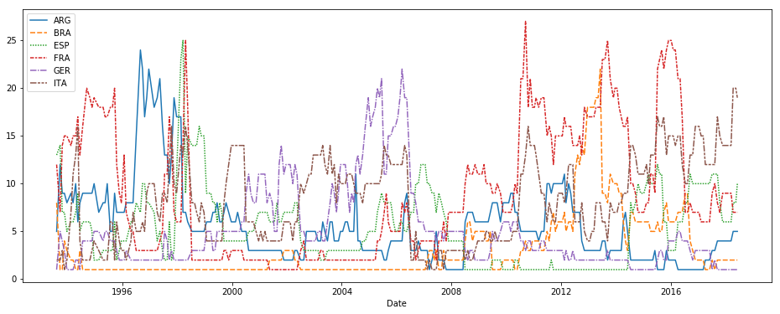
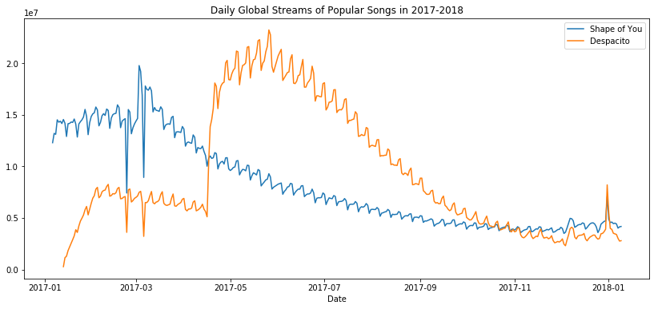
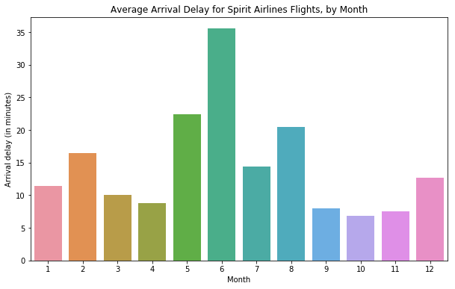
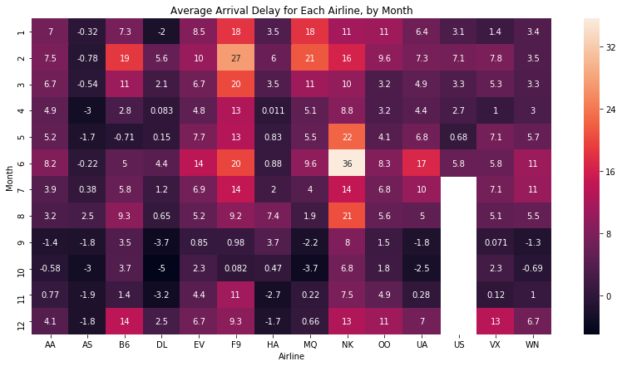
Seaborn - Basic Chart Types
Line Chart
# Line chart showing how FIFA rankings evolved over time sns.lineplot(data=fifa_data)
Line Chart Subset of Data
# Line chart showing daily global streams of 'Shape of You’ sns.lineplot(data=spotify_data['Shape of You'], label="Shape of You“ # Line chart showing daily global streams of 'Despacito’ sns.lineplot(data=spotify_data['Despacito'], label="Despacito")
Bar Chart
# Bar chart showing average arrival delay for Spirit Airlines flights by month sns.barplot(x=flight_data.index, y=flight_data['NK’])
Heatmap
# Heatmap showing average arrival delay for each airline by month sns.heatmap(data=flight_data, annot=True)

Slide 4
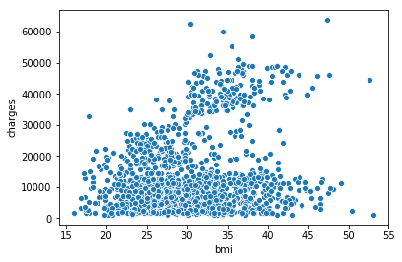
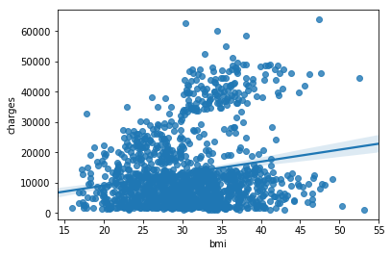
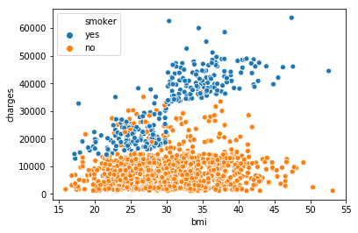
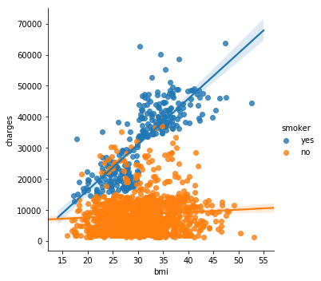
Seaborn -Scatter Chart
Scatter Plot
sns.scatterplot(x=insurance_data['bmi'], y=insurance_data['charges’])
Scatter Plot with Regression Line
sns.regplot(x=insurance_data['bmi'], y=insurance_data['charges'])
Color Coded Scatter Plots
sns.scatterplot(x=insurance_data['bmi'], y=insurance_data['charges'], hue=insurance_data['smoker’])
Color Coded Scatter Plots with multiple regression lines
sns.lmplot(x="bmi", y="charges", hue="smoker", data=insurance_data)
The sns.lmplot command above works slightly differently than the commands you have learned about so far:
Instead of setting x=insurance_data['bmi'] to select the 'bmi' column in insurance_data, we set x="bmi" to specify the name of the column only.
Similarly, y="charges" and hue="smoker" also contain the names of columns.
We specify the dataset with data=insurance_data.

Slide 5
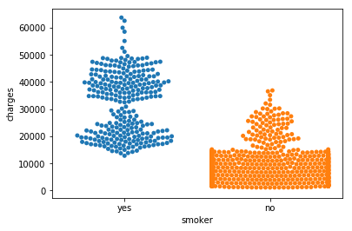
Seaborn - Scatter Chart Type ConT’d
Swarm Plot
sns.swarmplot(x=insurance_data['smoker'],y=insurance_data['charges’])
Finally, there's one more plot that you'll learn about, that might look slightly different from how you're used to seeing scatter plots. Usually, we use scatter plots to highlight the relationship between two continuous variables (like "bmi" and "charges"). However, we can adapt the design of the scatter plot to feature a categorical variable (like "smoker") on one of the main axes. We'll refer to this plot type as a categorical scatter plot, and we build it with the sns.swarmplot command

Slide 6
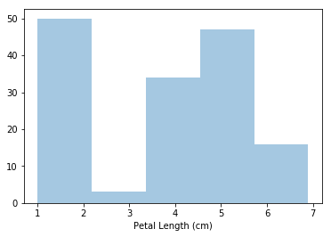
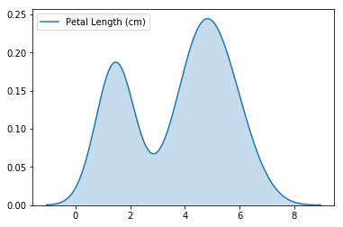
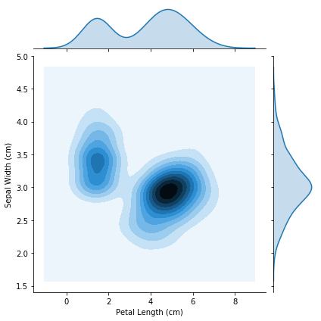
Seaborn – Histogram And Density Charts
Histogram
sns.distplot(a=iris_data['Petal Length (cm)'], kde=False)
Kennel Density Estimate
sns.kdeplot(data=iris_data['Petal Length (cm)'], shade=True)
2-D Kernel Density Estimate
sns.jointplot(x=iris_data['Petal Length (cm)'], y=iris_data['Sepal Width (cm)'], kind="kde")

Slide 7
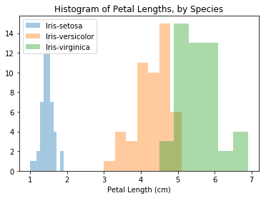
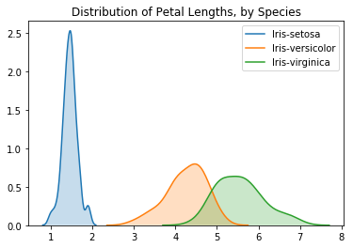
Seaborn – Histogram And Density Comparison
# Paths of the files to read
iris_set_filepath = "../input/iris_setosa.csv"
iris_ver_filepath = "../input/iris_versicolor.csv"
iris_vir_filepath = "../input/iris_virginica.csv"
# Read the files into variables
iris_set_data = pd.read_csv(iris_set_filepath, index_col="Id")
iris_ver_data = pd.read_csv(iris_ver_filepath, index_col="Id")
iris_vir_data = pd.read_csv(iris_vir_filepath, index_col="Id") # Histograms for each species
sns.distplot(a=iris_set_data['Petal Length (cm)'], label="Iris-setosa", kde=False)
sns.distplot(a=iris_ver_data['Petal Length (cm)'], label="Iris-versicolor", kde=False)
sns.distplot(a=iris_vir_data['Petal Length (cm)'], label="Iris-virginica", kde=False)
# Add title
plt.title("Histogram of Petal Lengths, by Species")
# Force legend to appear
plt.legend()
# KDE plots for each species
sns.kdeplot(data=iris_set_data['Petal Length (cm)'], label="Iris-setosa", shade=True)
sns.kdeplot(data=iris_ver_data['Petal Length (cm)'], label="Iris-versicolor", shade=True)
sns.kdeplot(data=iris_vir_data['Petal Length (cm)'], label="Iris-virginica", shade=True)
# Add title
plt.title("Distribution of Petal Lengths, by Species")

Slide 8
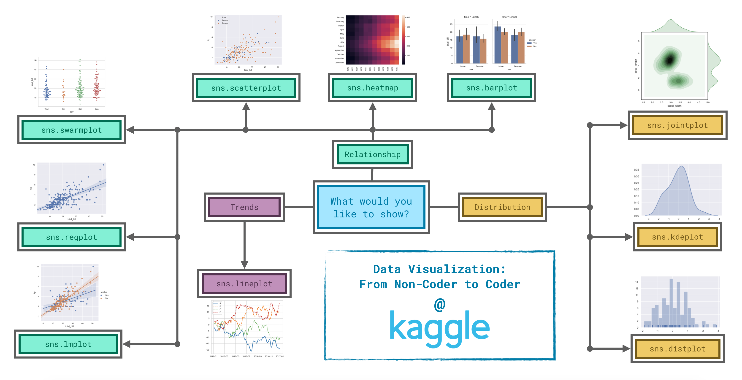
Seaborn Summary Cheat Sheet

Slide 9
Seaborn Summary Cheat Sheet
Trends - A trend is defined as a pattern of change.
sns.lineplot - Line charts are best to show trends over a period of time, and multiple lines can be used to show trends in more than one group.
Relationship - There are many different chart types that you can use to understand relationships between variables in your data.
sns.barplot - Bar charts are useful for comparing quantities corresponding to different groups.
sns.heatmap - Heatmaps can be used to find color-coded patterns in tables of numbers.
sns.scatterplot - Scatter plots show the relationship between two continuous variables; if color-coded, we can also show the relationship with a third categorical variable.
sns.regplot - Including a regression line in the scatter plot makes it easier to see any linear relationship between two variables.
sns.lmplot - This command is useful for drawing multiple regression lines, if the scatter plot contains multiple, color-coded groups.
sns.swarmplot - Categorical scatter plots show the relationship between a continuous variable and a categorical variable.
Distribution - We visualize distributions to show the possible values that we can expect to see in a variable, along with how likely they are.
sns.distplot - Histograms show the distribution of a single numerical variable.
sns.kdeplot - KDE plots (or 2D KDE plots) show an estimated, smooth distribution of a single numerical variable (or two numerical variables).
sns.jointplot - This command is useful for simultaneously displaying a 2D KDE plot with the corresponding KDE plots for each individual variable.

